Slide 1


Generative AI
Overview, Use Cases and Demo
May 2024

Slide 2
AGENDA
Key points
1
3
5
7
2
4
6
Solution
Approach
Path
Forward
Generative AI Initiative Goal
Value Chain
& Solutions Concept
Demo
Generative AI Overview
Generative AI Use Cases

Slide 3

Generative AI Initiative Goal
Identify Areas
To identify potential areas within Apar's business operations where Generative Artificial Intelligence (Gen AI) can optimise efficiency and conversion rates, cut costs, shorten delivery cycles, and elevate the overall customer and employee experience.

Slide 4
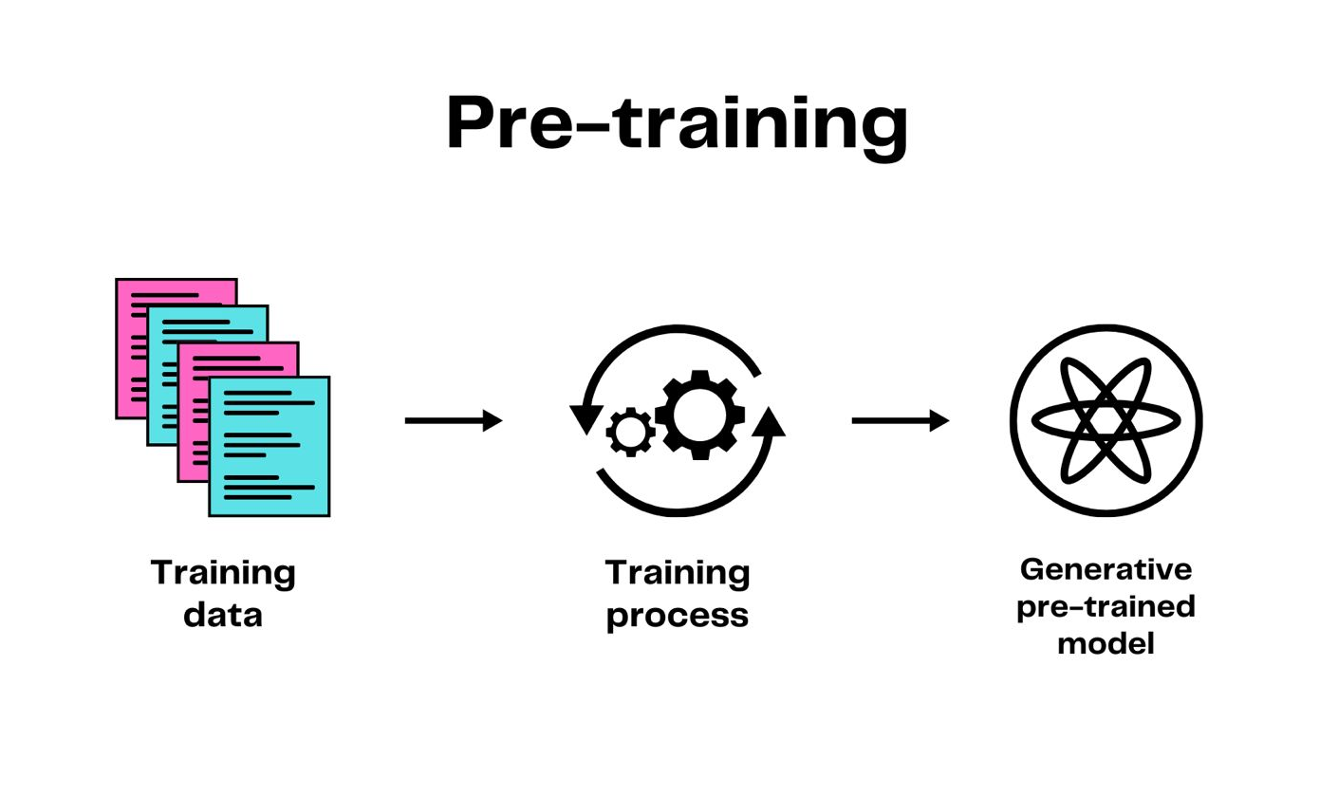
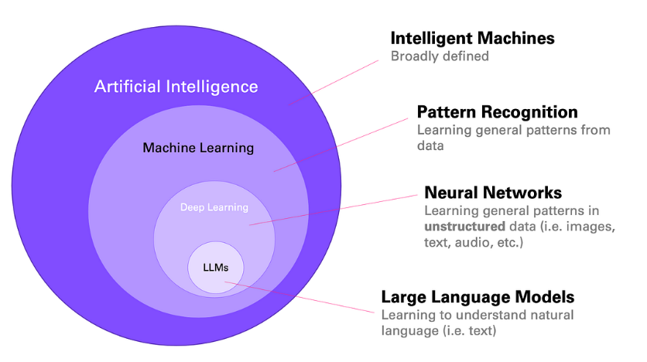
Generative Artificial Intelligence
Gen AI Overview
An approach to artificial intelligence that enables users to generate new synthetic content such as video, text, images, and sounds. It closely resembles human language.
Computer experts input extensive datasets and guide customized algorithms to generate outcomes. This process, known as training, converts the computer system into a Generative pre-trained model or Large Language Model.
E.g. Finding saltshaker at the Restaurant

Slide 5
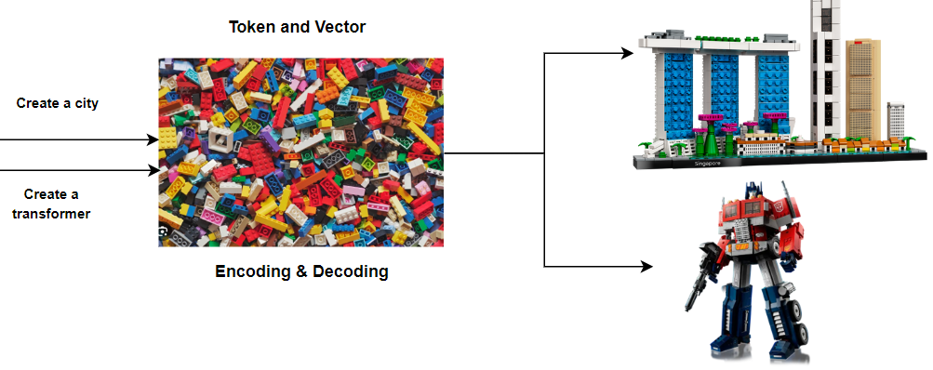
Generative AI Model – Part 1
Transformer overview
Large language model (LLM) built on transformer architecture trained on vast text data. It specialises in developing coherent and contextually relevant text.
OpenAI’s GPT (Generative Pre-trained Transformers) is one special example of LLM, and it was trained using 175 billion parameters.
Transformer Architecture

Slide 6
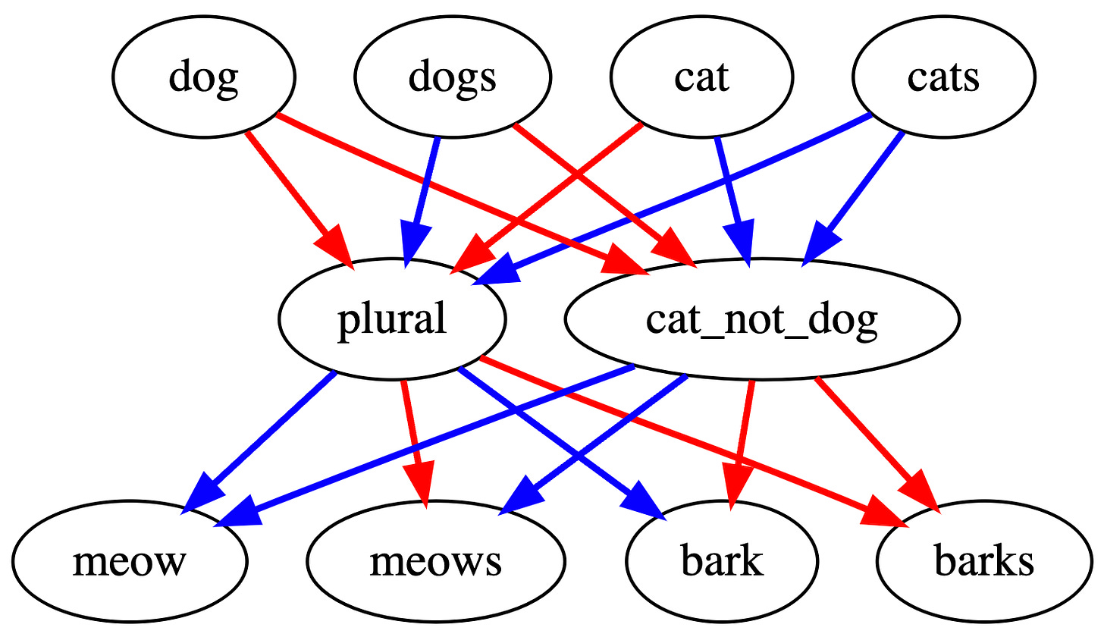
Generative AI Model – Part 2
Large Language Model
Large refers to the number of neurons, also called parameters (above 1 billion neurons as large) in the neural network.
A Language model

Slide 7
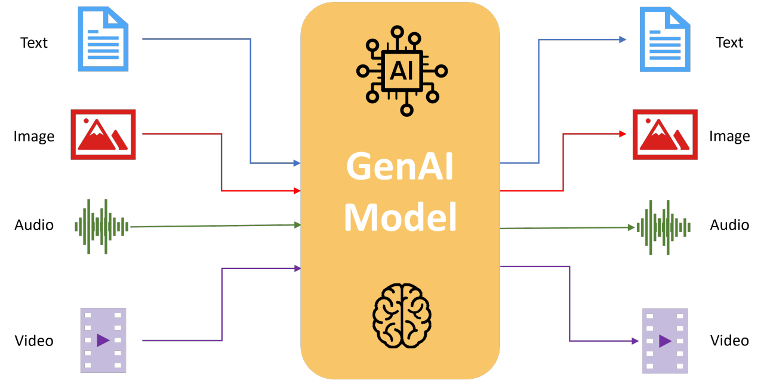
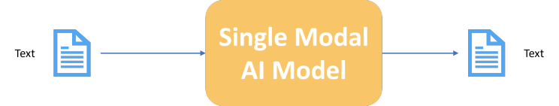
Gen AI Model Types & Benefits
Unimodal and Multimodal
E.g. OpenAI’s GPT-3
Popular Gen AI Models
Text-to-Text: ChatGPT, Bard, LLaMa, PaLM 2, Claude
Text-to-Image: Firefly, Midjourney, DALL-E 3, Stable Diffusion
Text-to-Audio: AutoLM, Jukebox, MuseNet, AudioLM
Text-to-Code: Codex, Alphacode, GitHub Copilot, PolyCoder
Text-to-Video: Runway, Cuebric, Artbreeder Video
Audio-to-Text: Whisper, DeepSpeech, Vosk, Jasper
E.g. OpenAI’s GPT-4

Slide 8
Gen AI Solution Approach
Enablement
1
3
4
2
3
5
Identify business goals, use cases and challenges
Buy versus Build
POC to Production
.
Test and validate
Identify the optimal AI modal
Training and Pilot Testing

Slide 9
Generative AI Use Cases
Business Operation Functions
Sales
Marketing
Recruitment
Create a client profile
Automated meeting notes
Create effective sales collaterals
Content Creation
Social Media Sentiment Analysis
Resume Screening and Matching
Profile Enhancement
Resume Summary
HR
Finance
Software Engineering
Create employee orientation materials, onboarding plan
Performance review analysis & create a training plan
Fraud detection & prevention
Predictive financial models
Report analysis
Code generation and refactoring
Automated testing plan
Auto-documentation
Notes:
Establish business integrated IT team - 1. Nippon Singapore team (Any Express business), 2. Sales team, 3. Shared IT team, 4. Regional IT team

Slide 10
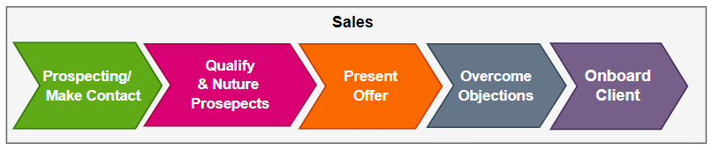
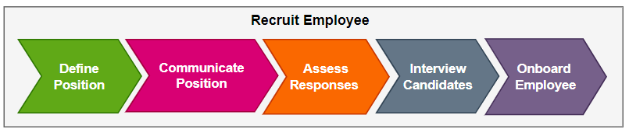
Apar’s Business Value Chain & Solutions Concept
Sales & Recruitment
Generative AI Capability
Generative AI Capability

Slide 11
Generative AI
Use Cases Demo
DEMO
Sales
Recruitment
Create a client profile
Auto generated meeting notes
Resume Screening and Matching
Profile Enhancement

Slide 12

Path Forward
Next steps
Set up organization-level direction in Gen AI – training, policies, etc.
Set priority within use cases for implementation
COTS versus custom solutions/build analysis
Core team formation & project execution

Slide 13
Accelerate Agility
THANK YOU

